Slide 1
PRINCIPAL COMPONENT REGRESSION
BY DEEP CONTRACTOR

Slide 2
What is Principal Component regression?
In statistics, principal component regression (PCR) is a regression analysis technique that is based on principal component analysis (PCA).
Then what is Principal Component Analysis?
Principal Component Analysis is an unsupervised learning algorithm used for dimensional reduction.
Principal component regression (PCR) is an alternative to multiple linear regression (MLR) and has many advantages over MLR.

Slide 3
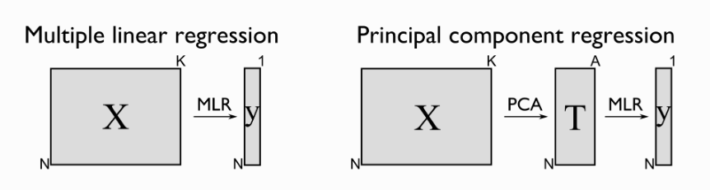
MLR VS PCR

Slide 4
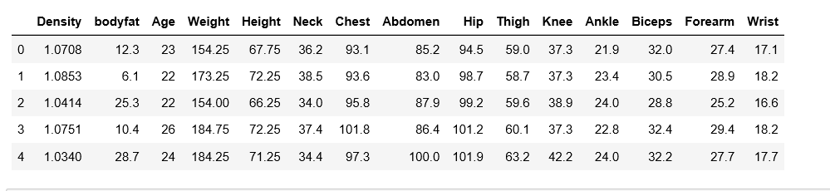

Slide 5
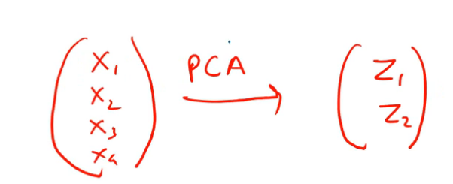
Principal component analysis(PCA)
Dimension reduction technique
It combines features
PC < initial features
Not a feature selection method

Slide 7
Steps to perform pcr
Step 1 : perform standard scaler/Minmax scaler
Step 2 : perform PCA on predictor variables
(n principal components)
Step 3 : perform regression on those principal components

Slide 8
Pros and cons
Removes Correlated Features
Improves Algorithm Performance
Reduces Overfitting
Improves Visualization
*********************************************
Data standardization is must before PCA
Information Loss

